Slide 1
Introduction to Unsupervised Learning
Jake Marshall
Data Science Lecturer

Slide 2
What is Unsupervised Learning?
Type of machine learning where algorithms are trained on unlabelled data.
Aims to find patterns, structures, or relationship in the data without predefined labels.

Slide 3
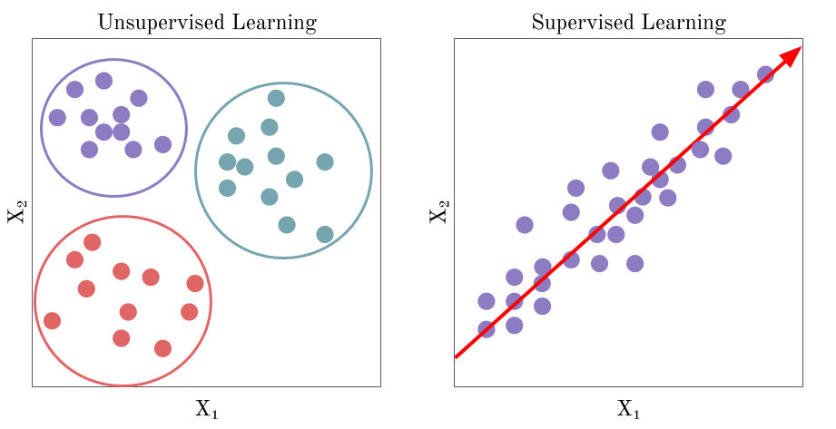
Supervised vs Unsupervised Learning

Slide 4
Unsupervised Learning: Objectives
Extract useful information from raw data without labelled examples
Identify patterns, clusters, or relationships within data to provide valuable insights
Notes:
This has been hotly debated in the past on whether it provides value but is steadily becoming very important with government data.

Slide 5
Unsupervised Learning: Why
Plays an important role particularly in scenarios where labelled data is difficult to get or expensive to obtain
Many real-world datasets are unlabelled
Can be the perfect starting point to obtain a small subset of possible labels to inform supervised learning

Slide 6
Unsupervised Learning: Applications
Customer segmentation
Anomaly detection
Recommendation system
Medical imaging

Slide 7
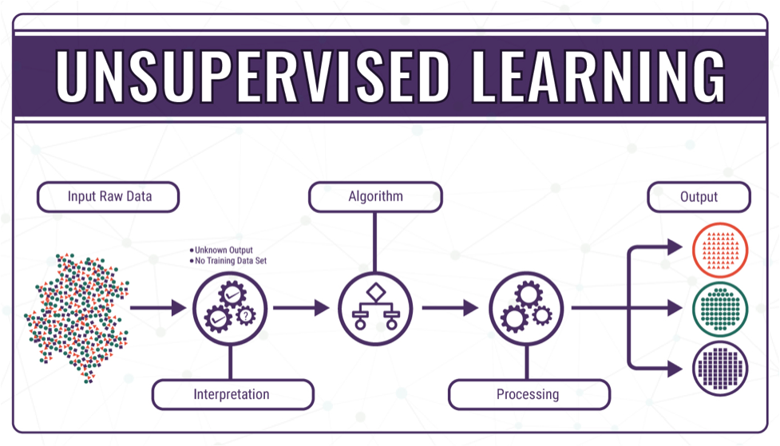
Unsupervised Learning: Methods
Clustering
Association
Dimensionality Reduction

Slide 8
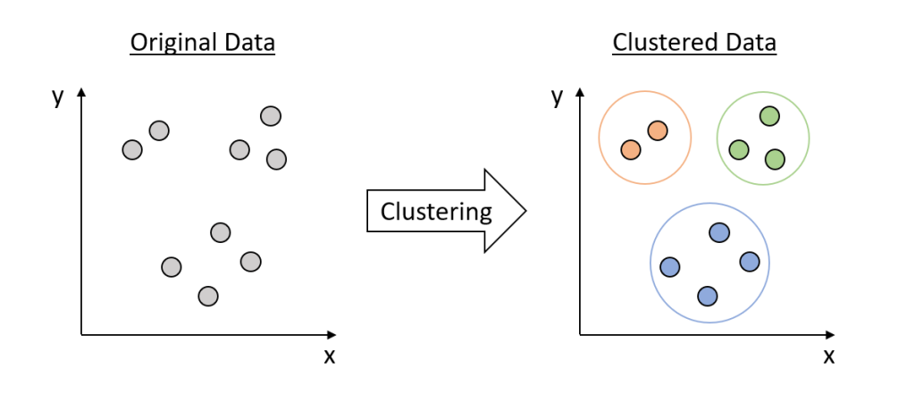
Clustering
Groups similar data points into cluster or groups
Goal is to identify the inherent structure or patterns within the data
Application includes image segmentation, anomaly detection and social network analysis.

Slide 9
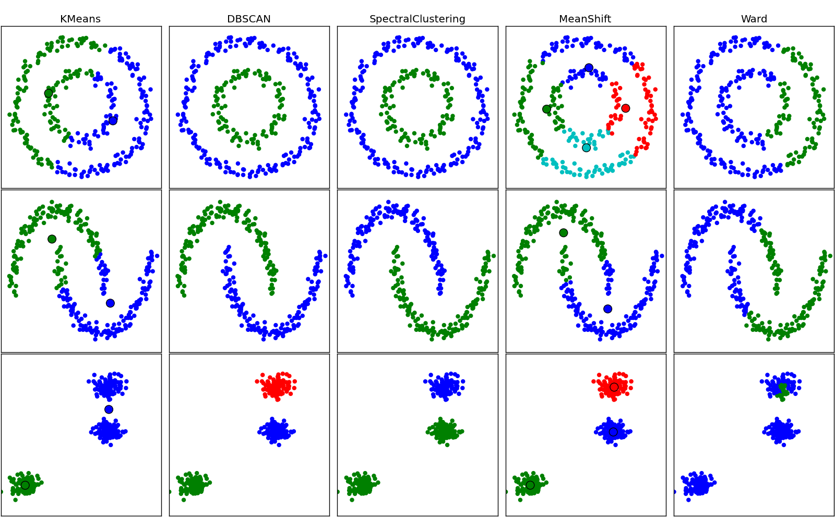
Clustering Algorithms
K-means
Density
Hierarchical
Probabilistic

Slide 10

Clustering: K-means
Divides data into a predefined number of clusters (K)
Each cluster represented by a centroid
Assigns data points to nearest centroid
Iterative process - updates centroid until convergence is achieved

Slide 11
Clustering: DBSCAN
Density-Based Spatial Clustering of Applications with Noise
Core algorithm for identifying clusters with spatial data
Identifies clusters based on density
Divides dataset into core, border & noise points
Core points expand to form clusters based on density connectivity
Border points are on the edge of clusters
Noise points do not belong to any cluster

Slide 12
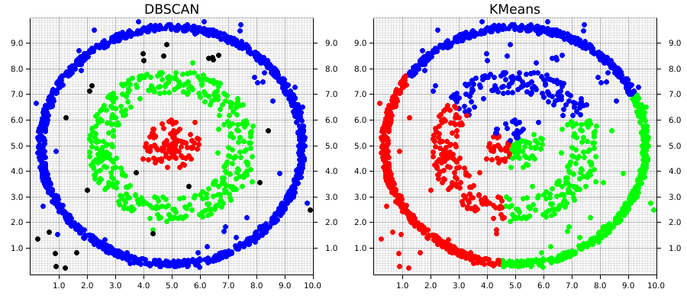
DBSCAN Visually
Robust to outliers and capable of handling cluster with different shape and size

Slide 13
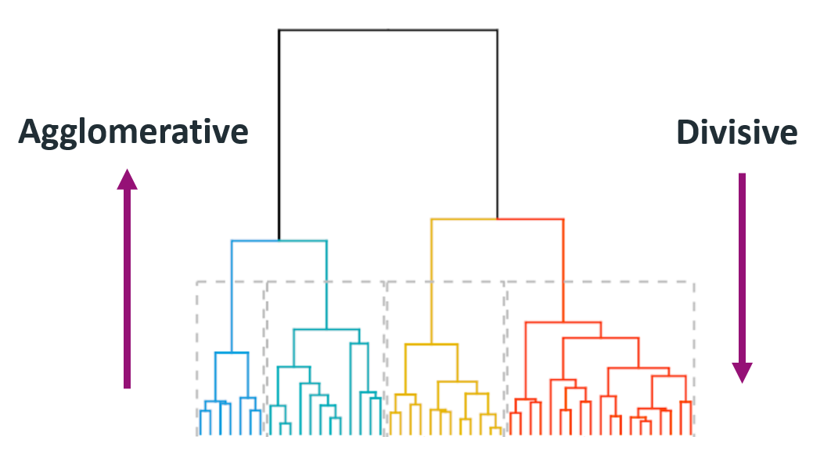
Clustering: Hierarchical
Builds hierarchy of clusters with either a top-down or bottom-up approach.
Agglomerative starts with each points as a separate cluster
Merge clusters based on similarity
Divisive begins with all points in single cluster
Splits clusters recursively

Slide 14
Clustering: Which Algorithm?
Analyse data characteristics
Assess dataset size, dimensionality, and distribution
Consider number of data points and features
Evaluate data distribution for complex structures
Define cluster requirements
Determine desire properties of clusters
Assess level of separation between clusters
Consider whether clusters should be tightly packed or spread out

Slide 15
Clustering: More considerations
Evaluate Computational Complexity
Assess scalability concerning dataset size and dimensionality
Evaluate runtime performance for real-time application
Experiment and validate
Experiment with multiple clustering algorithms
Compare results
Choose the algorithms that best meets the clustering objectives and computational constraints

Slide 16
Clustering: Silhouette Scores
Used to evaluate the quality of clusters produced by algorithms
Measures compactness (how close data points are to each other within the same cluster) separation (how far apart different clusters are from each other) between the clusters.
Ranges from -1 to 1:
Score close to 1 suggests the clusters are well separated and dense
Score close to -1 indicates overlapping clusters

Slide 17
Clustering: Davies-Bouldin Index
Computes average similarity between each cluster and its most similar cluster.
Helps identify optimal number of clusters for a dataset
Value closer to 0 indicates well separated and distinct clusters

Slide 18
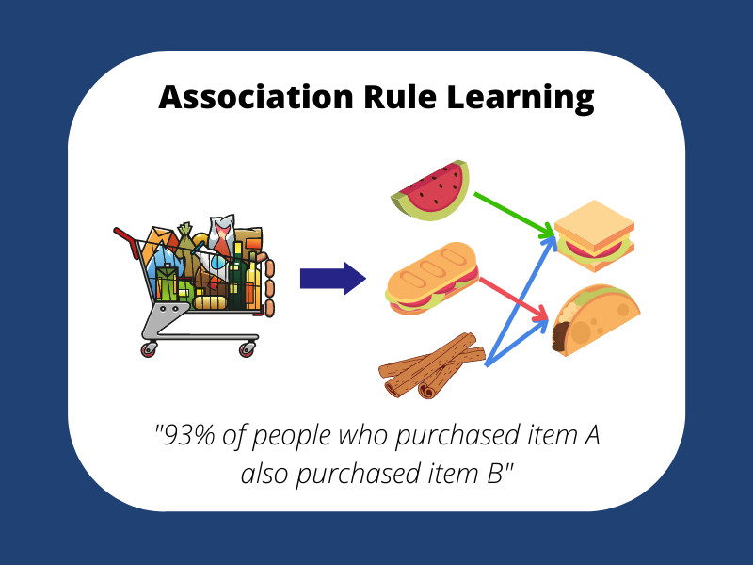
Association
Focuses on discovering relationships between variables
Identifies frequent patterns, correlations, or co-occurrences
Commonly used for anomaly detection, recommendation systems and market basket analysis

Slide 19
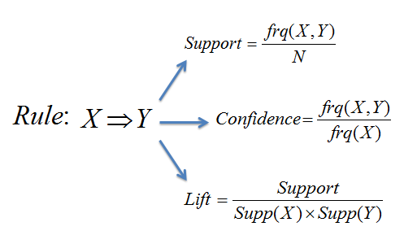
Association: Mechanisms
Relies on measures of interestingness:
Support – How frequently the itemset {X,Y} (products) appear in the transaction database.
Confidence – How strong the link between products X and Y are.
Notes:
If the support is 1%, then 1% of the transactions contain the item.

Slide 20
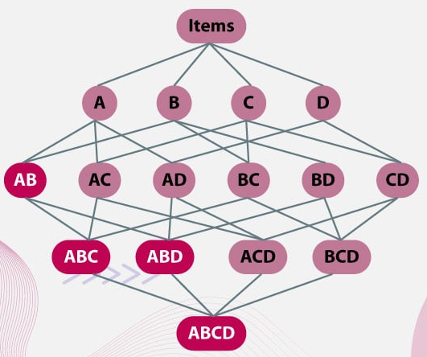
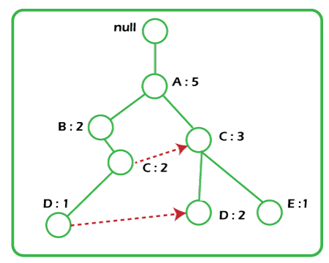
Association: Methods
Apriori
Generates frequent patterns by creating itemsets with pairing, grouping etc.
FP-Growth (Frequent Pattern)
Generates frequent patterns from a tree without need for itemset generation.

Slide 21
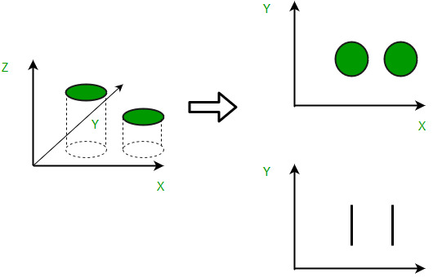
Dimensionality Reduction
Approach for reducing the number of features in a dataset
Aims to capture meaningful properties while minimising loss of information.
Commonly performed during pre-processing as a follow-up step for feature engineering
Notes:
A way of determining how well this performs is to capture the minimum loss of variance, ensuring this is low enough.

Slide 22
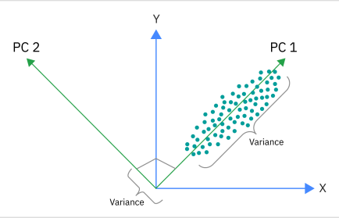
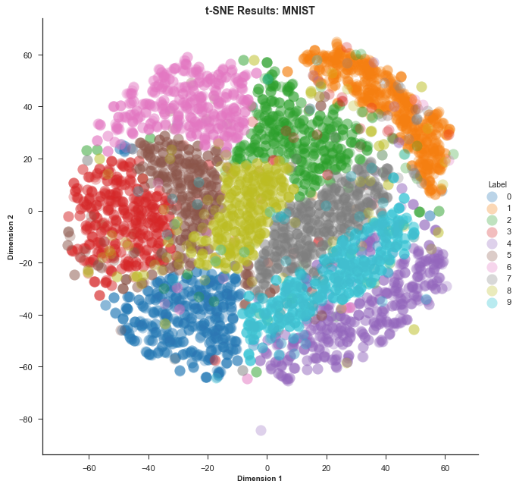
Dimensionality Reduction: Methods
t-distributed Stochastic Neighbour Embedding (t-SNE)
Principal Component Analysis (PCA)
Notes:
A way of determining how well this performs is to capture the minimum loss of variance, ensuring this is low enough.

Slide 23
Dimensionality Reduction: PCA
Linear technique that projects data from a high dimensional space to a lower dimensional space.
Takes linear combinations (sums) of features that are likely correlated to create a smaller set of uncorrelated features.
Each new feature is called a principal component, with the first capturing maximum variance.

Slide 24
Dimensionality Reduction: t-SNE
Allows separating of non-linear data that requires more than straight lines to be projected in lower dimensions.
Preserves relationships between data points as opposed to the minimising variance reduction.
Excellent for visualising high dimensional data.

Slide 25
Dimensionality Reduction: Evaluation
Reconstruction Error
Measures the difference between original data and its reconstructed form.
Lower error indicates retained information from original data.
Helps preserve important features while reducing dimensionality.

Slide 26
Unsupervised Learning: Challenges
Computational resources
Unsupervised learning can be computationally intensive
Usually big data
Requires efficient algorithms
Overfitting and Generalisability
Models may be prone to overfitting without labelled data
Capture noise or irrelevant patterns

Slide 27
Unsupervised Learning: Considerations
Interpretability
Output visualisations and clusters etc are complicated.
Challenge to interpret, especially for non-experts
Lack of transparency in how clusters/projections were formed.

Slide 28
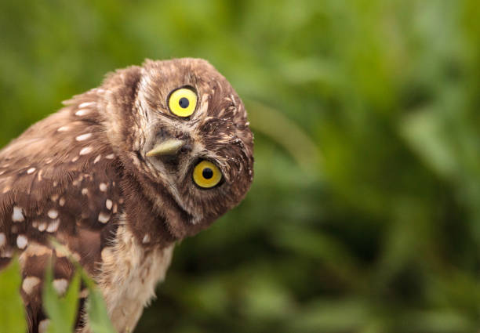
Questions?

